Slide 1

LEGO CAR
MINI DEVIL

Slide 2

https://youtu.be/KF3WRxIBJV4

Slide 3
Factors
Wheelbase (length): With an increase in the wheelbase length, there is a decrease in maneuverability but it results in an increase in stability, which might help in minimizing the chances of a crash on landing from the ramp.
While, on the other hand, if we decrease the wheelbase length, there might be a loss in stability, but it makes the car more maneuverable. Since our aim here was to increase the distance, we thought that stability and maneuverability might turn out as significant factors in determining that.

Slide 4
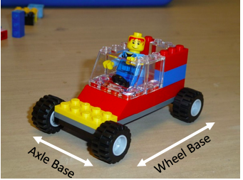
Factors
Axle (width): In general while designing a car, widening the distance between the tires i.e. increasing the length of the axle, helps to increase the stability of the car which would affect the speed, the distance and the direction in which it travels on landing. Hence, length of the axle became a factor which we wanted to test.

Slide 5
Factors
Wheel Size: The thought process behind choosing the wheel size as one of the factors was that generally larger LEGO wheels are faster than the smaller ones but the friction also comes into picture when considering the wheel size. Hence, we concluded that the wheel size would be one of the important factors in determining the distance travelled by our car.

Slide 6
Factors
Weight: In general, the higher the weight of the car, the more energy is spent to increase the speed. But, since in our case we had to prepare for a downhill race, adding more weight to the car made sense because it might increase the speed of the car while moving down, which might result in a larger distance that the car covers on landing.

Slide 7
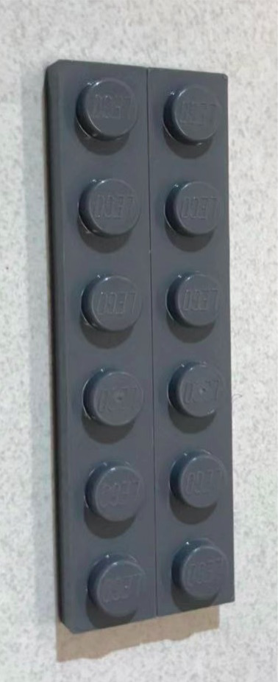
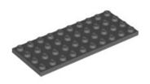

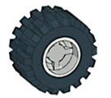
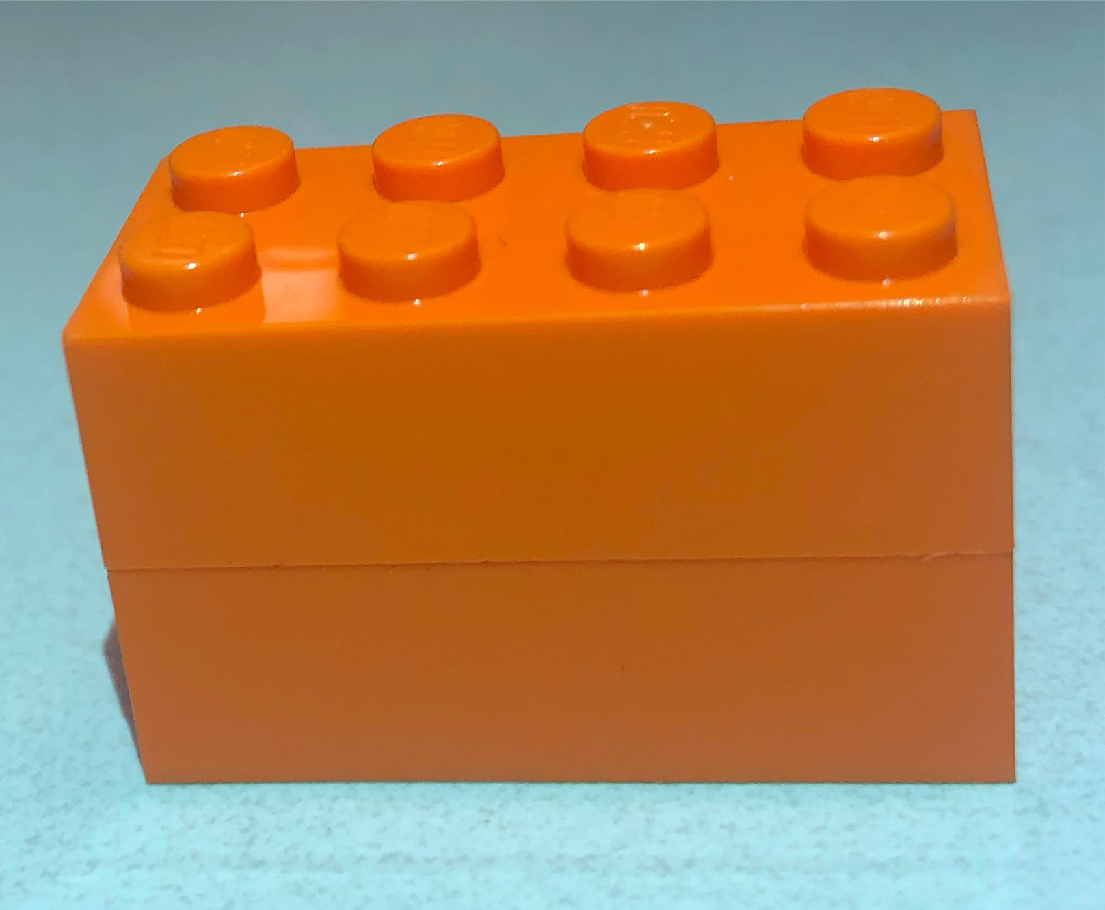
Factor Levels
Factors | Low Factors | High Factors
Wheelbase (Length) | Six Dots Long | Ten Dots Long
Axle (Width) | Two Dots Wide | Four Dots Wide
Wheel Size | Small | Large
Weight | No Extra Weight | Addition of Two 4x2 Bricks

Slide 8
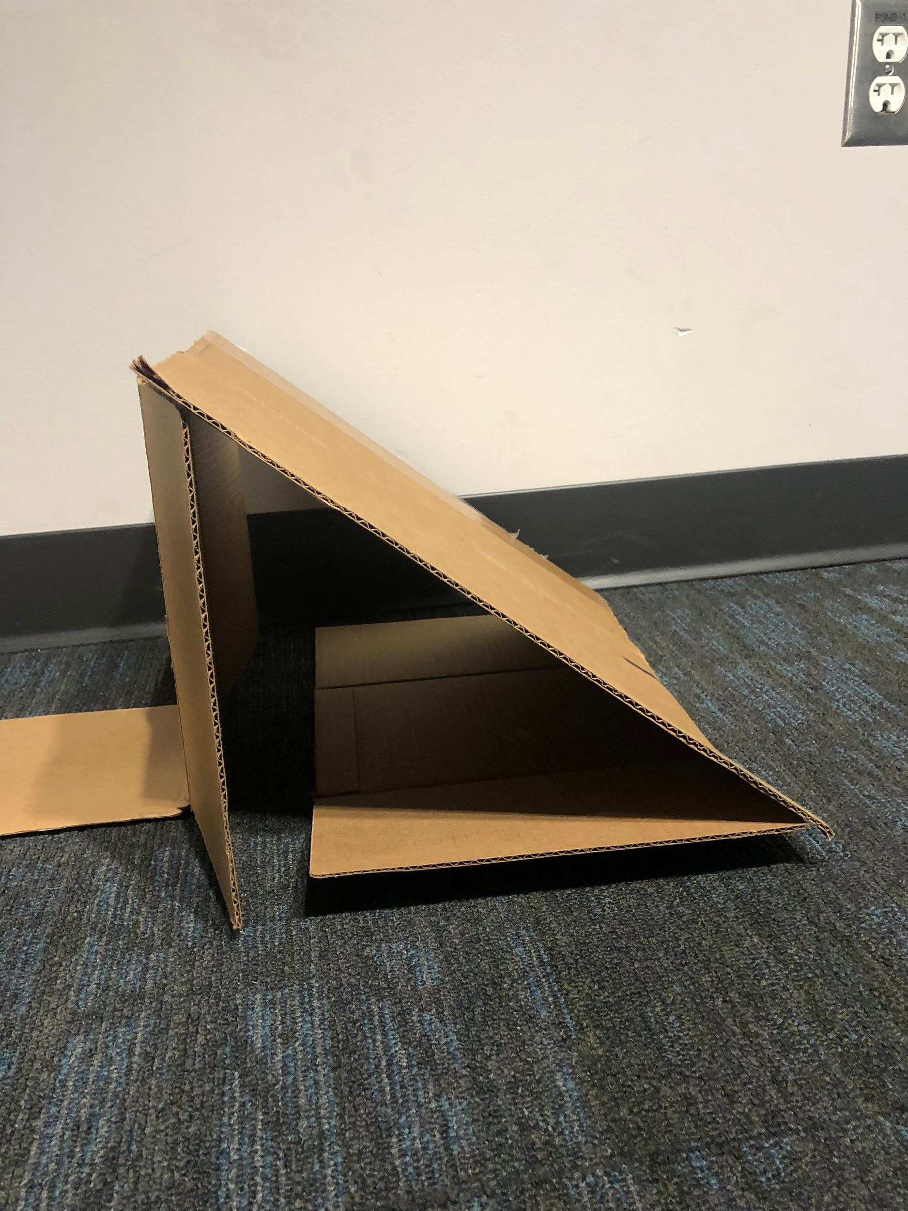
Experiment Set-Up
Ramp: cardboard,
40 degree angle
10 inches high
16 inches long
Floor: carpeted floor
Traveled Distance: from the end of
ramp to the rear
wheel of our car
Full Factorial
Factor Combination: 16
Replicates: 2
Total Runs: 16*2=32

Slide 9

Considerations
Wheel Size: Cars with small front wheel crashed every time. Hence, we fixed the front
wheel to be always larger. Only consider rear wheel size.
Operator: One and only one operator to let the car slide down from ramp in order to
prevent unexpected influence.
Floor: Carpeted floor. Different material floors may affect travelled distance.Since almost
every classmates run experiments on carpeted floor and our car will race in
classroom with same carpeted floor, this can be negligible.

Slide 10
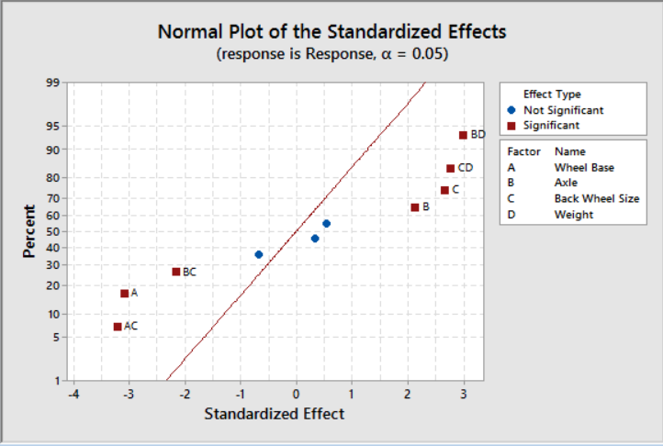
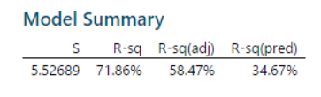
Significant Factors
Significant Factors:
One-way factor:
Wheelbase（A)
Axle（B)
Back wheel size(C)
Two-way interaction factor:
Wheelbase X back wheel size(AC)
Axle X back wheel size(BC)
Back wheel size X weight (CD)
Axle X weight (BD)
Notes:
Sparsity

Slide 11
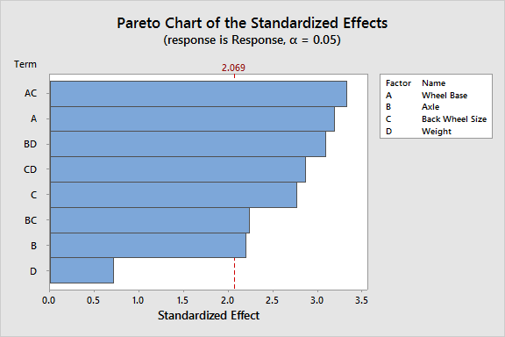
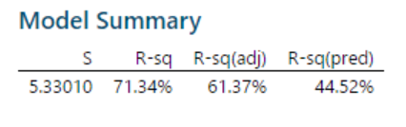
Model Refinement
Wheelbase is the most significant one-way term.
Wheelbase and back wheel size is the most significant two-way interaction term.
Decided to include weight due to significant interaction term.

Slide 12
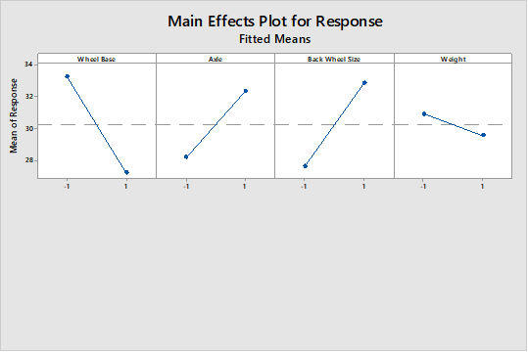
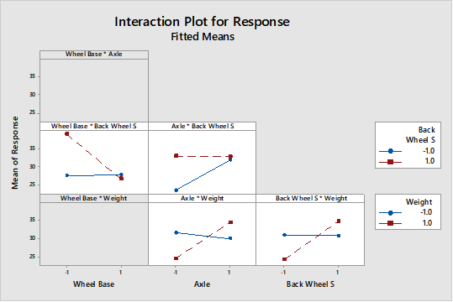
Main Effects and Interaction Plots

Slide 13
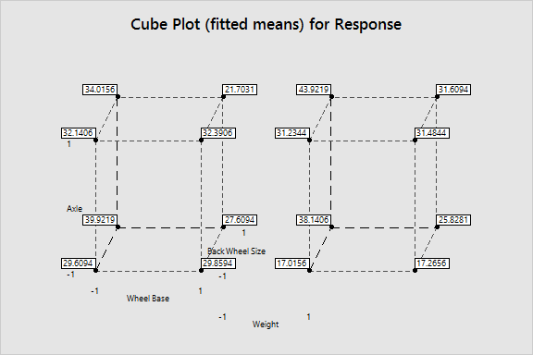
Decisions
The farthest traveling car will have the following characteristics:
A short wheelbase
A wide axle
Large back tires
And extra weight added

Slide 14
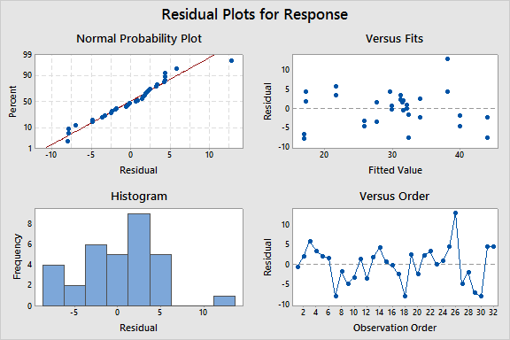
Model Validation
The residuals of our model are normal and heteroskedastic.

Slide 15
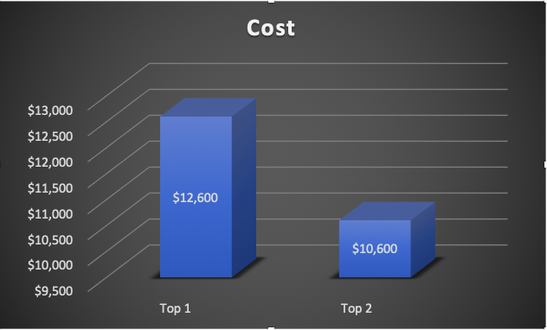
Cost Analysis
Performance Model (Top1)
Longer travelled distance
Slightly higher production cost
Discriminable consumers
Standard Model (Top2)
Competitive travelled distance
Lower production cost
Price-sensitive consumers

Slide 16
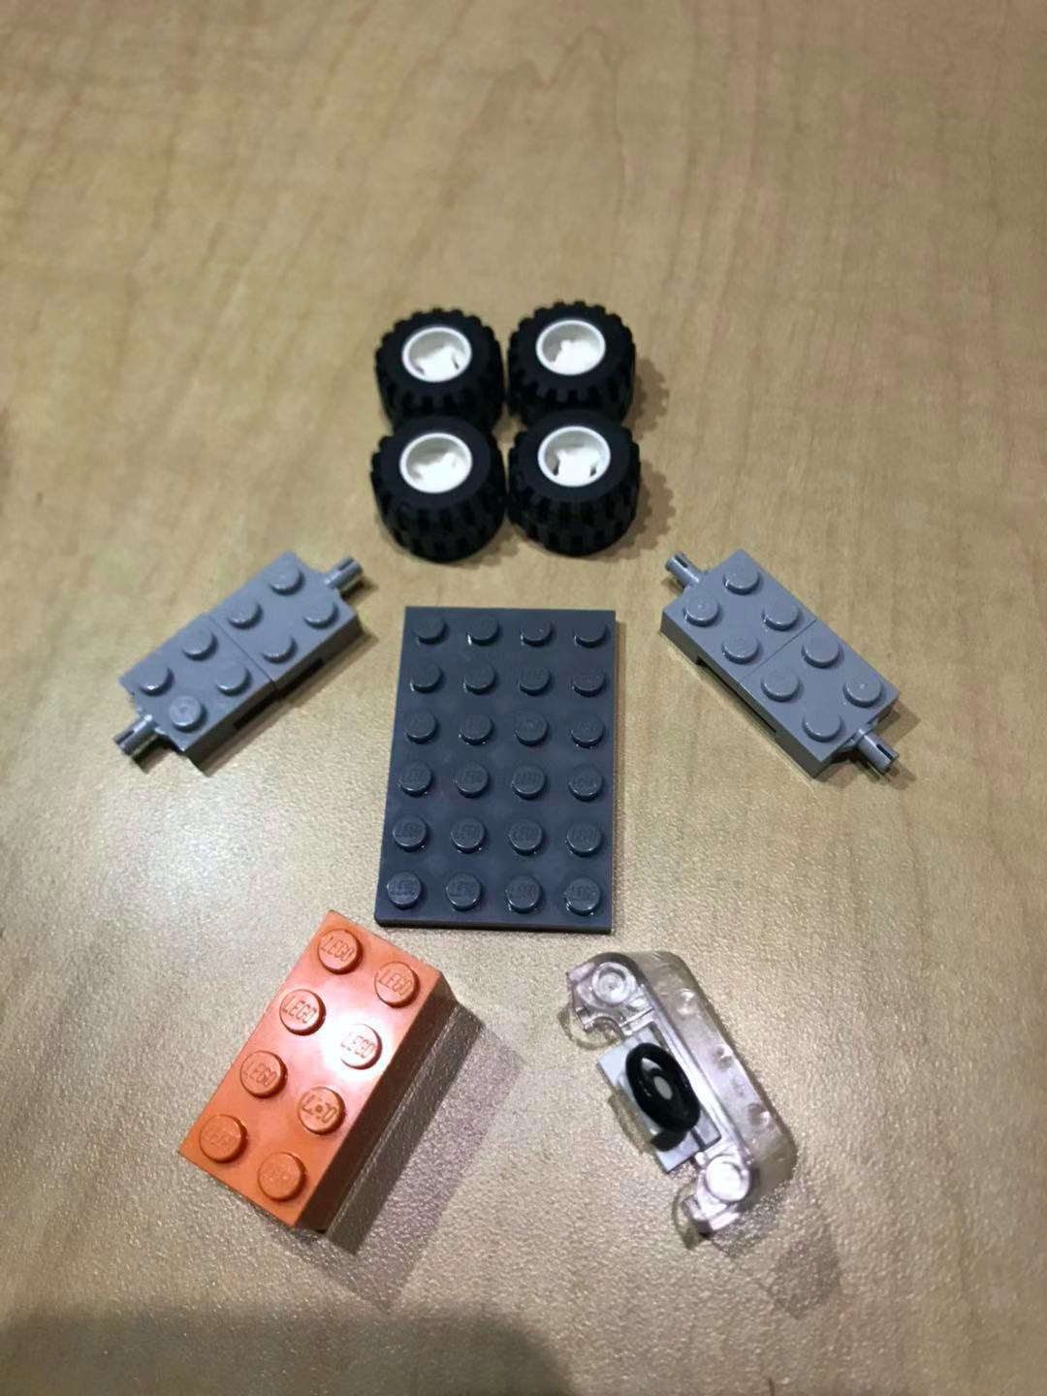

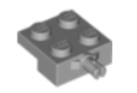


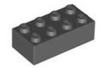
Cost Analysis
Parts of Car | Price Per Unit($) | Quantity | Cost for Parts
 | 1000 | 4 | 4000
 | 2000 | 1 | 2000
 | 1000 | 4 | 4000
 | 500 | 1 | 500
 | 100 | 1 | 100
 | 1000 | 2 | 2000
 |  | Total Cost | 12600

Slide 17
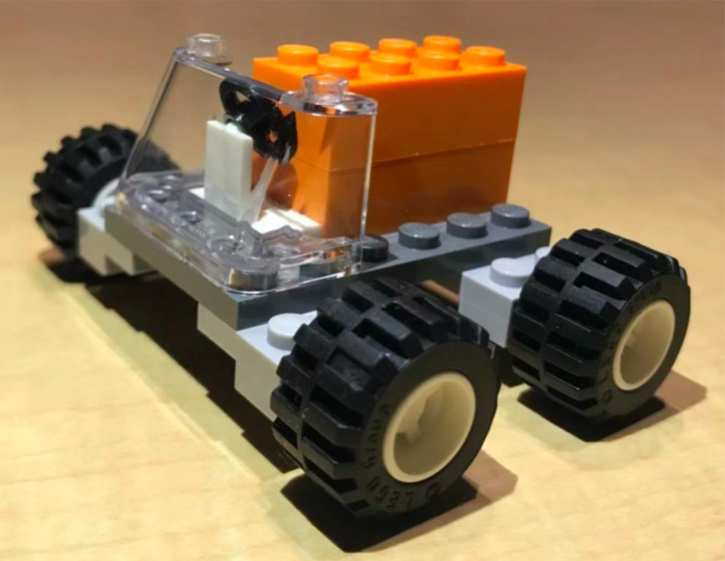

Cost Analysis
Just $ 12600 !!!

